Slide 1
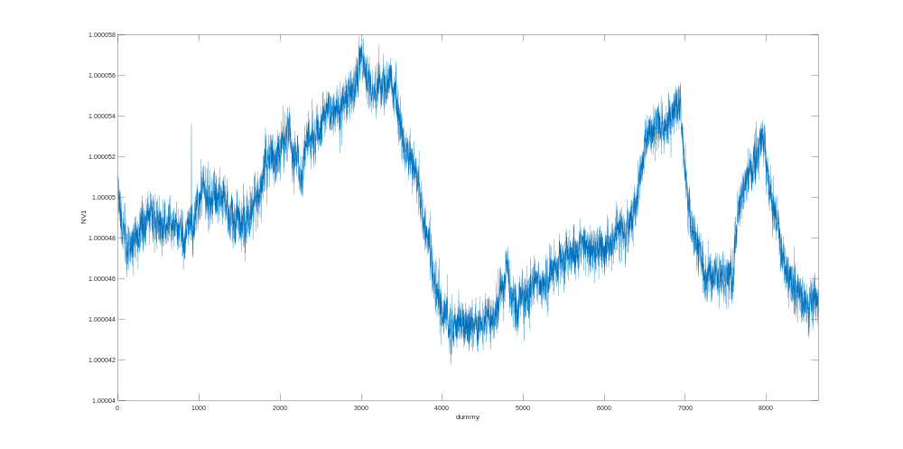
20220713_YOKOGAWAGS200_LongTerm_002.mat
7/14/2022 9:29 AM
Y1 = 1
Start Time: 20220713 0928
End time: 20220714 0928
Range for Yokogawa GS200: 10V
Range for Keathley 2182: 1V
Slow Mode, Filter On
More Details:
-Right side of the Electronics Bench
-Along with the Yokogawa GS200 at the top
-Around 5 people in lab

